Slide 1
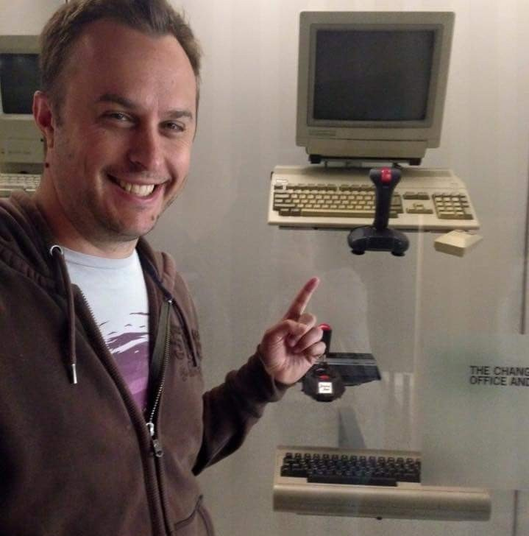
Xamarin - Redux
Andrew Revell
Mobile Developer - Fraedom @llevera & arevell@gmail.com
Notes:
About me

Slide 2
What to expect
Beginner
Developing, building and running a Xamarin Forms MVVM app
Intermediate
Potential Problems with more complex MVVM apps, intro to Redux
Advanced
Considerations when using Redux in a real project
1
2
3

Slide 3
MVVM app
1

Slide 4
Code!
1

Slide 5
Potential problems
namespace Redux.ViewModels { public class ItemViewModel : BaseViewModel { private readonly Item _item; private readonly ItemsViewModel _itemsViewModel; public ItemViewModel(Item item, ItemsViewModel itemsViewModel) { _item = item; _itemsViewModel = itemsViewModel; } public string Text => _item.Text; public int Quantity { get => _item.Quantity; set { _item.Quantity = value; _itemsViewModel.UpdateSummaries(); OnPropertyChanged(nameof(TextColor)); } } public Color TextColor { get { if (Quantity < 1) return Color.Gray; switch (_item.Category) { case ItemCategory.Fruit: return Color.Orange; case ItemCategory.Vegetable: return Color.Green; case ItemCategory.Meat: return Color.Red; default: return Color.Gray; } } } } }
2
View Models mix
State
State change
UI Mapping
Service calls
Validation
Propagation
State
State change
Propagation
UI Mapping

Slide 6
Code!
2

Slide 7
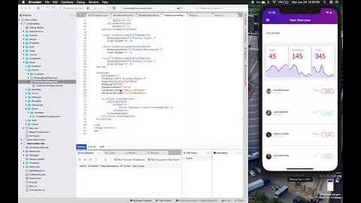
But First!
3
AOT Startup Profiling for Android
AndroidX
Hot Reload

Slide 8
Redux
2
Used within
React
Angular
Flutter
etc

Slide 9
Redux
2

Slide 10
Code!
2

Slide 11
Real project considerations
3
Immutability
Performance
Binding work arounds
Error handling

Slide 12
More reading
3
General/JS
https://redux.js.org/
C#
https://medium.com/@to_pe/xamarin-forms-with-redux-part-1-4a3a043cbc41
https://medium.com/pageup-tech/advanced-redux-in-xamarin-part-1-action-creators-19cb257093d2
https://spin.atomicobject.com/2017/03/13/adapting-redux-c-sharp-xamarin/

Slide 13
Thanks!

